Slide 1
DATA 110 / PROJECT 01
INSIDE THE
NETFLIX
N
CATALOG
A data-driven look at content types, categories,
countries, and movie durations
8,807 TITLES
4 VISUALIZATIONS
Rameen Irfan | DATA 110 | October 28, 2026
01

Slide 2
Why Netflix?
I chose the Netflix dataset because it's a platform I'm familiar with, and I was curious to explore its content through data. I wanted to see which genres of shows and movies are most common, which countries have the most titles, and how movie lengths vary. The dataset also gave me the opportunity to explore different patterns through visualizations.
8,807
WHAT I WANTED TO EXPLORE:
For this project, I focused on four main questions:
Does Netflix have more movies or TV shows?
What are the most common categories on Netflix?
Which countries have the most titles represented on Netflix?
What is the most common movie duration on Netflix?
MOVIES + TV SHOWS
12 columns • Kaggle CSV
Catalog through September 2021
02

Slide 3
Getting to know the data before plotting
Basic checks helped me make more reliable comparisons.
8,807
12
0
831
rows
columns
identical duplicate rows
missing country values
HOW THE DATA WAS PREPARED
Some titles list multiple categories or countries. I separated these values and counted each individually. Missing country entries were excluded from the country chart. For the histogram, I used only movies and converted durations from text to minutes.
EXPLORATORY DATA ANALYSIS
04

Slide 4
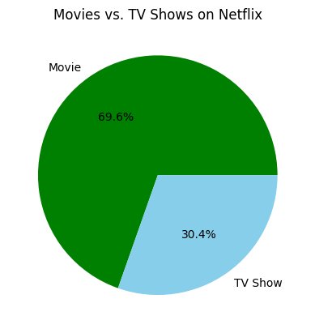
Movies or TV shows?
Does Netflix have more movies or TV shows?
KEY FINDING
69.6% movies
Movies account for 6,131 titles, compared with 2,676 TV shows (30.4%). The pie chart makes the difference in proportions easy to see.
Figure 1 • Share of the 8,807 listed titles.
05

Slide 5
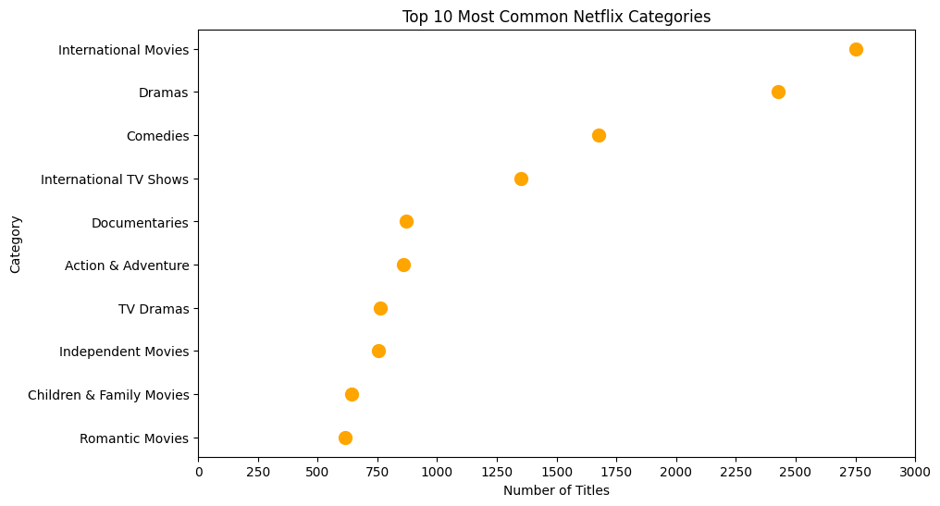
Which categories lead?
What are the 10 most common Netflix categories?
KEY FINDING
Out of the 8,807 titles in the dataset, 2,752 are categorized as International Movies
International Movies is the most frequent category, followed by Dramas (2,427) and Comedies (1,674). The dot plot helps compare category counts.
Figure 2 • A title can appear in multiple categories; counts overlap.
06

Slide 6
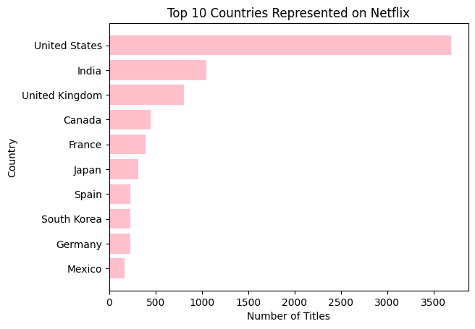
Where is content represented?
Which countries are associated with the most titles?
KEY FINDING
3,690 US titles
The United States leads, followed by India (1,046) and the United Kingdom (806). The bar lengths show how much larger the U.S. count is. Some titles are associated with multiple countries, so they were counted under each country listed.
Figure 3) 831 country values are missing.
07

Slide 7
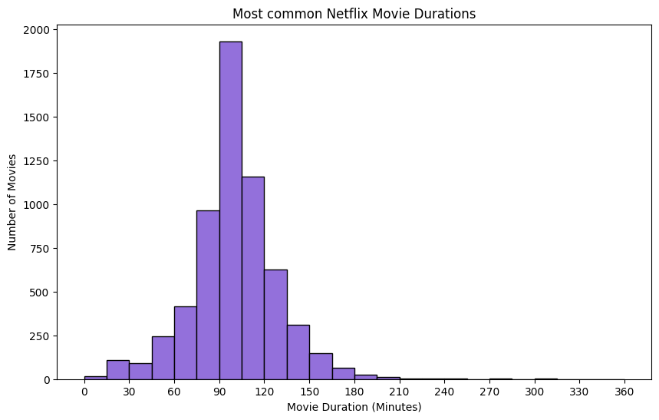
Distribution of movie durations on Netflix.
What movie-duration range is most common in the dataset?
KEY FINDING
90–120 minutes
Movie durations cluster around 90–120 minutes. The histogram groups lengths in 15-minute intervals, making typical movie lengths easy to spot.
Figure 4 • Movie durations only; missing durations are excluded.
08

Slide 8
CONCLUSION
What the catalog reveals:
Four key takeaways from the Netflix dataset.
01
MOVIES DOMINATE
Nearly 7 in 10 listed titles are movies.
02
CATEGORIES OVERLAP
International Movies, Dramas, and Comedies lead.
03
US IS MOST REPRESENTED
The U.S. has the highest number of associated titles.
04
MOVIE DURATIONS
Many movies run approximately 90–120 minutes.
LIMITATION
The dataset includes the catalog through September 2021, not Netflix’s current catalog.
09

